Slide 1
Data Visualizations Using Available Datasets
Muhammad Shahid Saleem

Slide 2
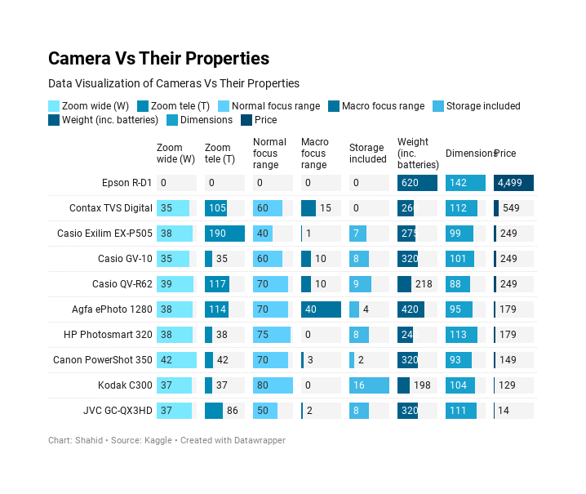

Slide 3
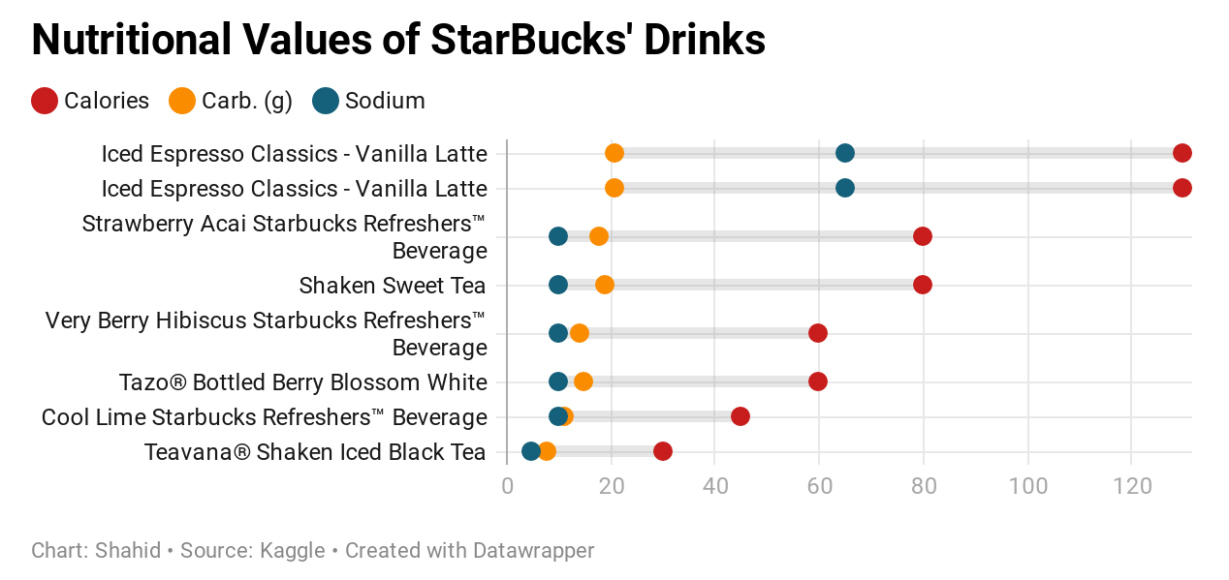

Slide 4
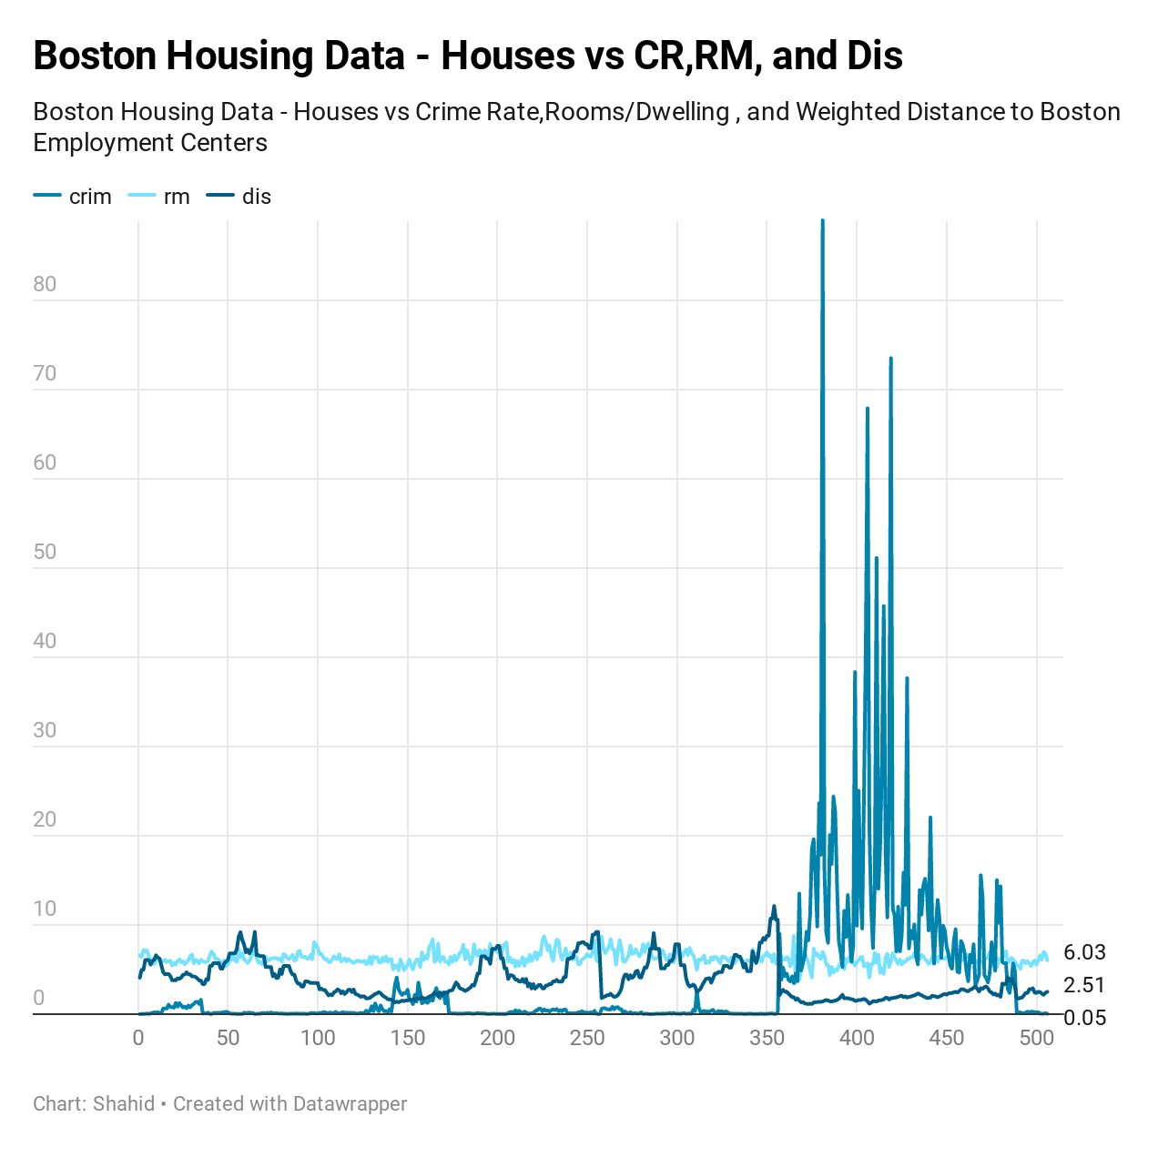

Slide 5
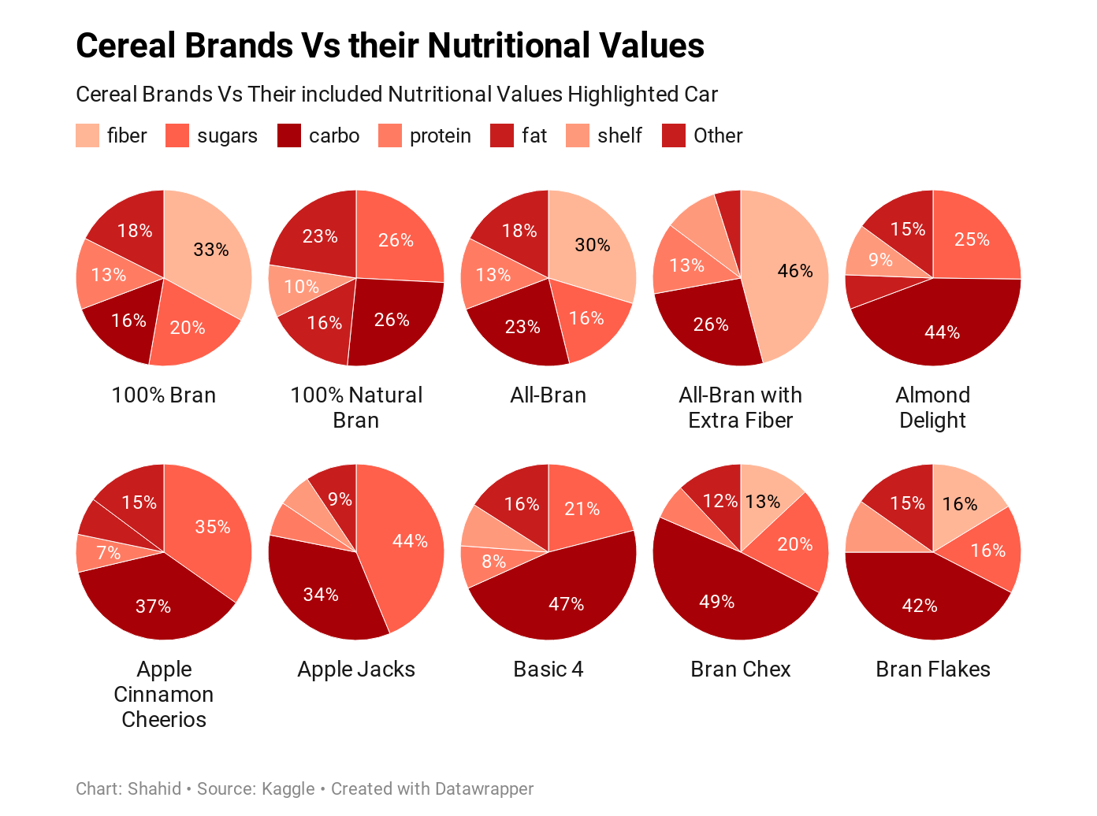

Slide 6
End

